Slide 1
Master Project Final Report
First-principles studies of quantum defect candidates in 2D WS2
Ning Siyuan
18/06/2024
Notes:
Thank you for being here today. My name is Ning Siyuan I’m going to present my Master Project, about…

Slide 2
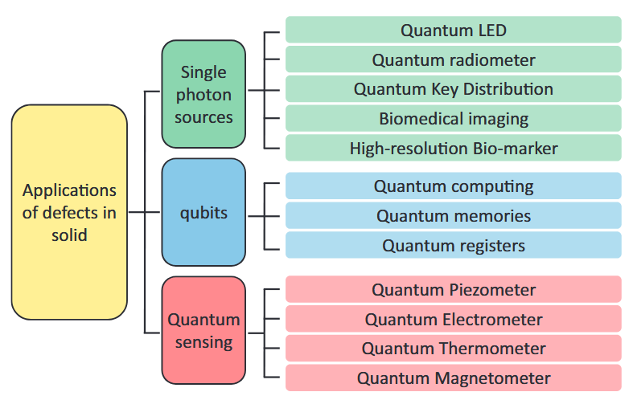
Background
Quantum point defect
Notes:
Defects are defined by their spin, optical and charge states, as well as by the properties of their host material.
point defects exhibiting quantum properties determined are called quantum point defect

Slide 3
Background
Quantum point defect in 2D material
Controllable Defect Positions: Current experimental techniques enabling nearly deterministic defect positions. Also, strain, electric and magnetic fields can be intentionally engineered.
Stacking: 2D materials offer substantial flexibility in forming multi-layer structures . The layer-dependent electronic structures and interlayer couplings provide opportunities by incorporating an atom or molecule between layers
Surface: 2D materials inherently serve as excellent platforms for quantum sensing due to their surface properties. The embedding of SPEs in monolayers circumvents issues like total internal reflection common in 3D color centers, significantly improving light extraction efficiency.
Notes:
Controllable Defect Positions: Current experimental techniques allow for precise control over defect creation in 2D materials, enabling nearly deterministic defect locations essential for scaling qubits. Also, strain, electric and magetic fields can be intentionally engineered. The single-layer MoS2 layers, delta-doped diamond slabs, and Si thin slabs were predicted as promising hosts for spin qubits. Also, electrons are injected from the metallic tip into the discrete defect states of two-dimensional materials, selectively exciting individual defects without being affected by the luminescence of the bulk crystal background.
Versatile Stacking: 2D materials offer substantial flexibility in forming heterostructures with rotational or translational variants, leading to novel electronic and optoelectronic phenomena. The layer-dependent electronic structures and flat band correlations enhanced by different interlayer couplings provide opportunities for incorporating quantum bits, such as sandwiching an atom or molecule between layers. For instance, h-BN with an AA' stacking order functions as a wide-bandgap semiconductor suitable for deep ultraviolet emitters, photodetectors, and photon devices with strong single-photon emission. It also serves as an insulator in gate dielectrics, passivation layers, and atomic tunneling layers, with superior thermodynamic stability compared to other polymorphs.
Surface Properties: Beyond quantum computing and communication, 2D materials inherently serve as excellent platforms for quantum sensing due to their surface properties. The embedding of SPEs in monolayers circumvents issues like total internal reflection common in 3D color centers, significantly improving light extraction efficiency.
Isotopic Purity: Isotopic purification in 2D materials significantly extends spin coherence times, with records reaching up to 30 ms [Ye, M.; Seo, H.; Galli, G. Spin Coherence in Two-Dimensional Materials]. Compared to 3D materials, 2D vdW materials excel in controllable generation and manipulation of properties.

Slide 4
Background
Key quantities
Category | Defect properties
Basic ground-state properties | Geometries, defect formation energies, charge-state transition levels, ground-state spin multiplicity
Specific ground-state properties | Magnetic interactions (zero-field splitting, spin-orbit, hyperfine), vibrational modes and frequencies, electron-phonon coupling, spin-phonon coupling
Excited-state properties | Excited-state energies and geometries, multiplet structure, transition dipole moments, radiative rates, optical lineshapes, nonradiative transitions
Notes:
Methodology well-developed and accepted, widely implemented and tested, ready for high-throughput calculations
No principle difficulties, may be practical difficulties, not widely implemented yet, developments and testing taking place
Principle difficulties persist, rigorous approaches computationally very expensive, need for approximate methods that have to be tested more systematically

Slide 5
Background
Defects as spin qubits
Deep defect levels: Enhance the fidelity of stored quantum information. To prevent resonance with pristine band edges, quantum defects should have energy levels distinctly separated from the band edges.
High spin states: Essential for the initialization, operation, and readout of spin qubits. The simplest example of this would be two parallel unpaired spins.
Radiative recombination rate: Should be greater than the non-radiative rate, it ensures effective readout of spin qubits.
Weak coupling with environmental factors: When there's limited interaction with elements like phonons and nuclear spins, spin lifetime at room temperature is extended. This improves the duration of stored information and reduces qubit errors.
Notes:
Required Properties for spin qubits
By DFT calculated quantities

Slide 6
Workflow
Substitutional defects in monolayer WS₂
Determine defect supercell
manually set different initial dopant positions
ground state structure
with possible symmetry distortion
Calculate formation energy
defect charge states within pristine bandgap
Evaluate spin configuration
Singlet or triplet ground state
Bandstructure Analysis
defect level
Notes:
My current work is about … Flowchart
Some basic defect properties discussed in this work
Further Process

Slide 7
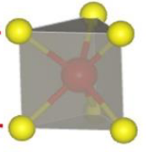
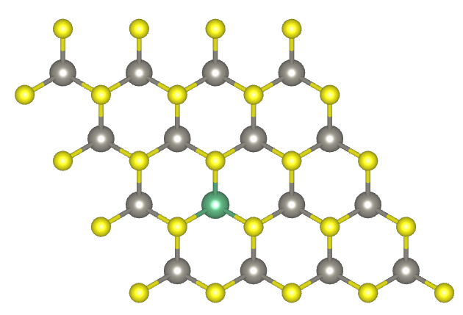
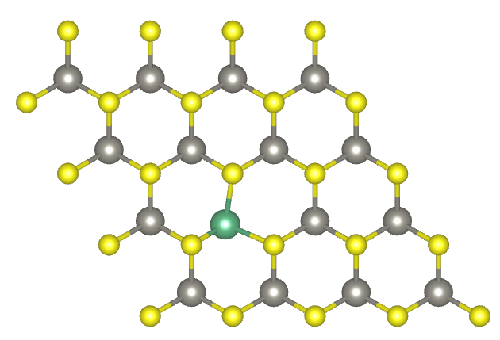
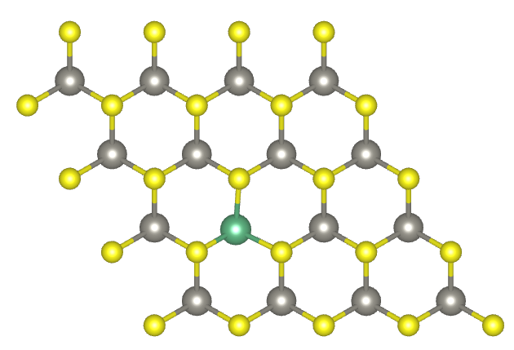
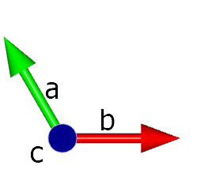
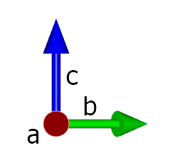
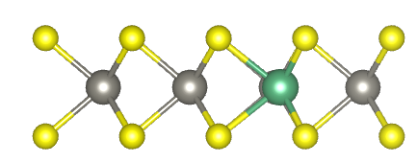
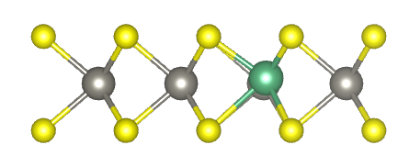
Defect Supercell
Initial Disruption Setting - relax the defect structures in symmetry broken supercells
Trigonal prismatic coordination → D_{3h}
no.1
no.2
no.3
(0.333 0.417 0.500)
(0.305 0.405 0.500)
(0.320 0.410 0.505)
Fig.1 Top views and side views of the possible structures and symmetries
Notes:
Unlike graphene, which is truly only one atom thick, TMDs are three atom thick, with the metal atom in the middle and chalcogenides top and bottom, adopting trigonal prismatic form. The host material in this work is 1H WS2 phase, where H stands for the hexagonal lattice. The trigonal prismatic coordination in it exhibits D3h point group.
To accurately identify the ground state. Three initial dopant positions are considered: one at the original W position, a second with a slight in-plane displacement, and a third with a displacement along a tilted out-of-plane direction. These settings have proved to be the most possible structures after relaxation.
In standard geometry relaxation, the vacancy/substitution/interstitial defect configuration is initialized on a known crystal site (Wyckoff position) with all other atoms retaining their original lattice positions. Such a simple setup tends to converge to a local minimum or a saddle point on the potential energy surface along with widely implemented gradient-based optimization algorithms in DFT codes. Thus, it is necessary to actively break the local symmetry of the host crystal to enable more distorted configurations to be sampled during relaxation.

Slide 8
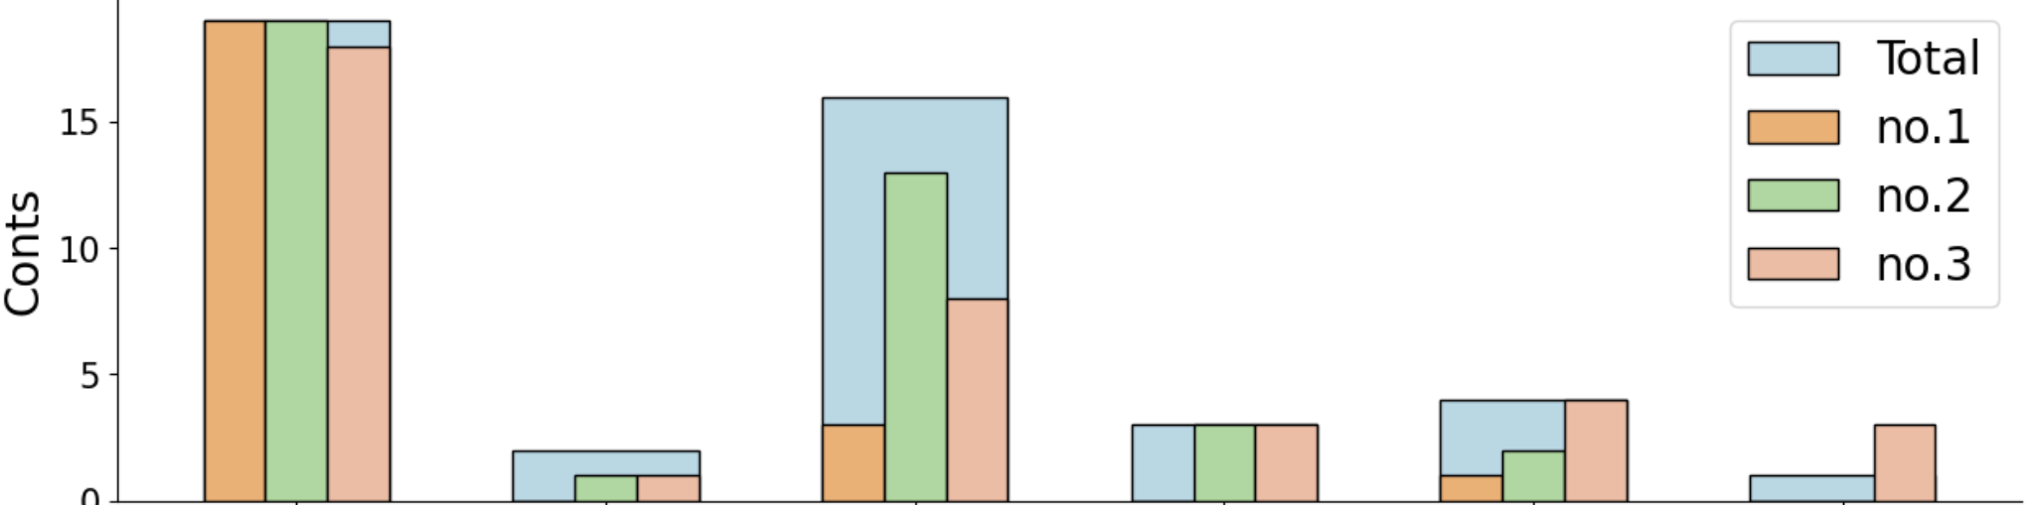
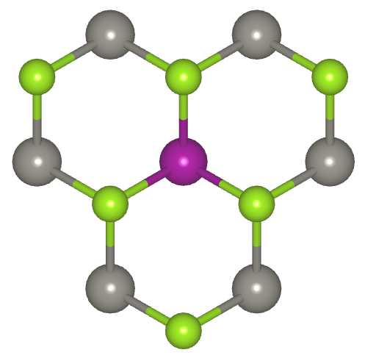
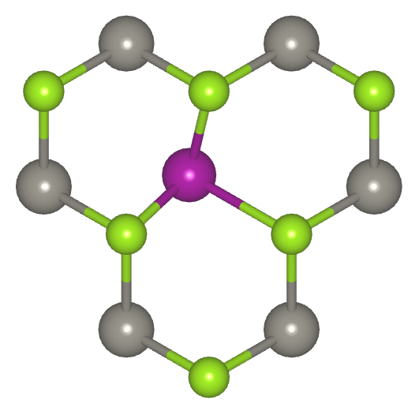
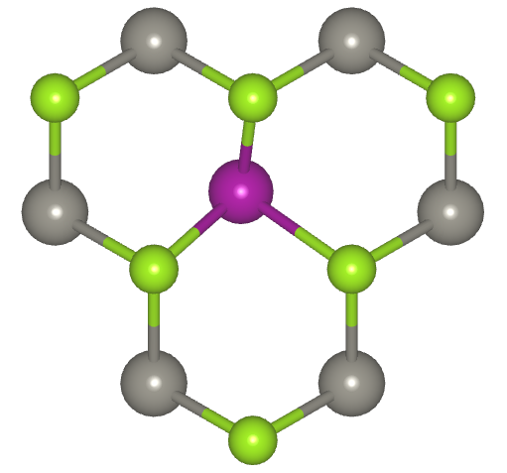
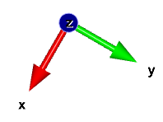
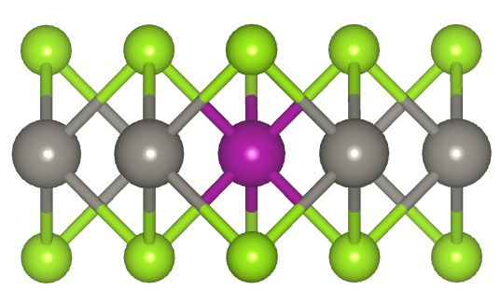
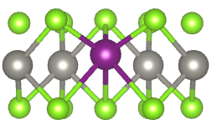
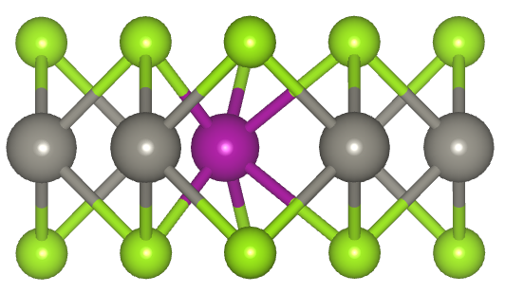
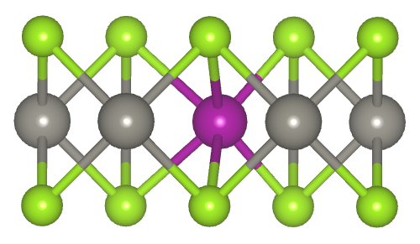
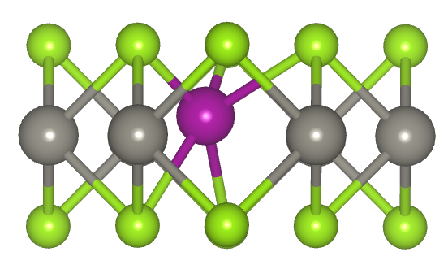
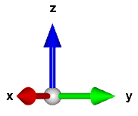
Defect Supercell
Distribution of point groups for relaxed defects
D_{3h}
C_{3v}
C_{2v}
C_{h}
C_{s}
C₁
D_{3h}
C_{3v}
C_{2v}
C_{h}
C_{s}
σ_{v}
C₂
σ_{v}
C₂
C₂
C₃(S₃)
C₃(S₃)
σ_{v}
σ_{v}
σ_{v}
σ_{v}
σ_{yz}
σ_{s}
C₂
σ_{yz}
σ_{s}
C₂
σ_{h}
σ_{h}
σ_{xy}
C₃(S₃)
C₃(S₃)
Notes:
Fully-relaxed local atomic structures
The distribution of point groups for relaxed defect structures (in Schönflies notation) is shown here. Out of the 48 relaxed structures, approximately 80% are $D_{3h}$ and $C_{2v}$, accounting for 42.2% and 35.5%, respectively. Structural distortions are widely present, with more than half of the structures reducing to point groups with lower symmetry. The subcolumns count the initial settings that yield the lowest energy geometries for each point group. For $D_{3h}$, all three initial coordinates consistently converge to the same configuration. However, for distorted structures, almost all lowest energy configurations are initialized by settings coordinate no. 2 and no. 3, the disrupted initial positions, whereas the first setting often traps the structure in a local minimum. This indicates that the deliberately introduced disruptions are effective.

Slide 9
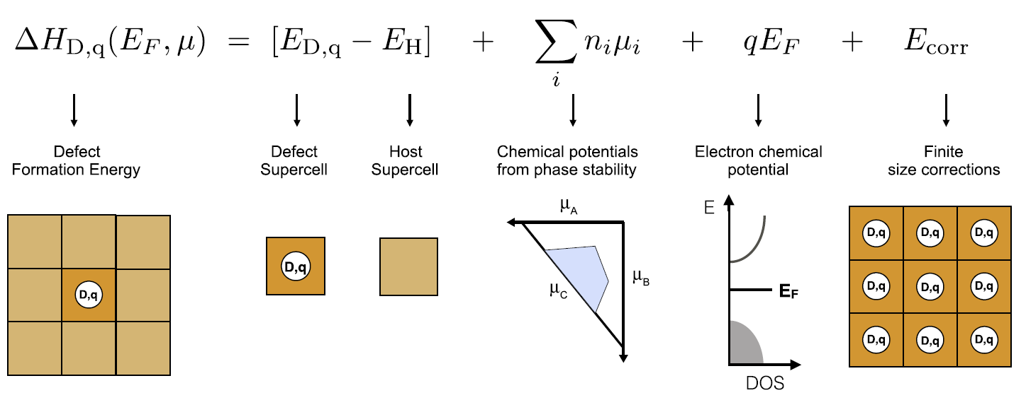
Defect Formation Energy
①
②
③
④
Goyal, A. et al, Comp. Mat. Sci., 2017, 130, 1-9
D = defect q = charge state H = host
n_{i} = number of atoms added to (negative) or removed from (positive) the host
μ_{i} = chemical potential i = atomic species
Notes:
With proper modeling, the formation energy of the defect D in the charge state q is calculated by this equation, and here is an illustration provided by Goyal's work:
There are four terms in this equation: The first term is the difference between the DFT calculated energies of the defect and host supercell. Terms 2 and 3 account for the energy shifts due to changes in atom and electron quantity. /cuz In defect formation, atoms and electrons are exchanged with the hypothetical reservoirs. The chemical potentials are introduced to reflect the reservoirs, which equals to the required energy to add or remove one particle.
The last term is the charge corrections, or finite-size correction within the supercell approach.
Term 1 is easily determined. The following discussions focus on chemical potential and charge correction.

Slide 10
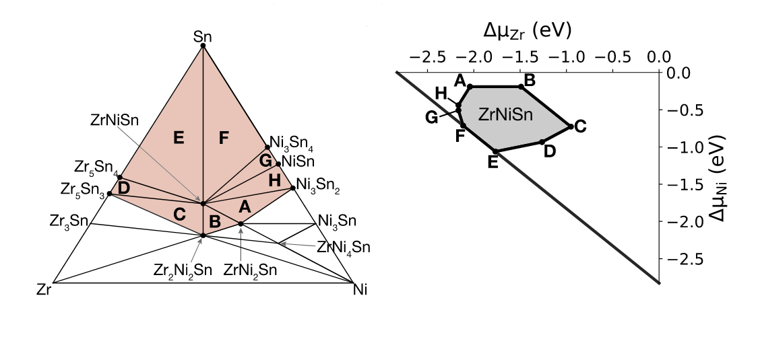
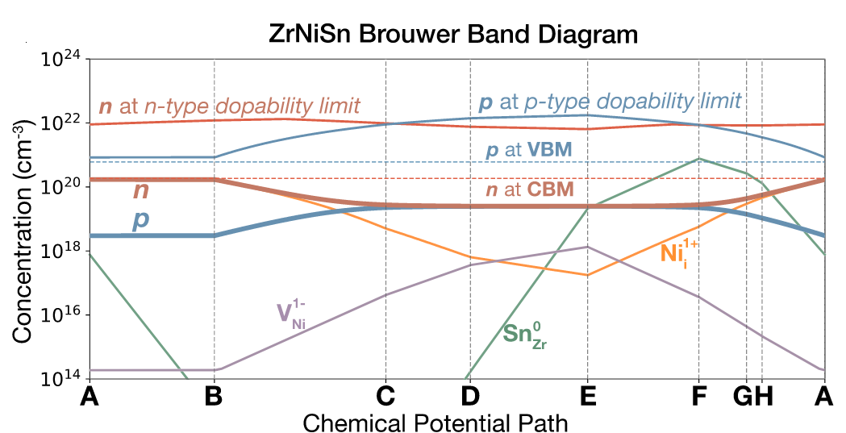
Chemical Potential Feasible Region & Limits
Fraction
Anand, S. et al. Acc. Mater. Res. 2022, 3 (7), 685–696.
Notes:
Introduce Feasible Region & limits
缺陷的形成能由化学势μ决定，化学势由前驱体、分压、温度等因素影响。因此，实验条件（化学势μ）决定了所有可能缺陷的形成能， stability region
The related properties, are evaluated considering the extreme values of the atomic chemical potentials, for which the system is in equilibrium with other phases. Outside this range, secondary phases would start to precipitate. 举例说明 ternary compounds with multi-segement boundaries in chemical potential space.
Brouwer Band Diagram of ZrNiSn. (a) Defect concentrations, charge carrier concentrations, electronic dopability limits and band edge information for ZrNiSn as a function of changing chemical equilibrium conditions calculated using data from ref.43 The chemical potential path A−B−C−D−E−F−G−H corresponds to thermodynamic equilibrium of ZrNiSn with two other impurity phases indicated in the red region of the Zr−Ni−Sn ternary composition space of (b). In chemical potential space (c), the path encloses the gray region which in which the ZrNiSn phase is stable. 所以能带的高对称点一样重要
Formation energies are also on the limiting values of the feasible region

Slide 11
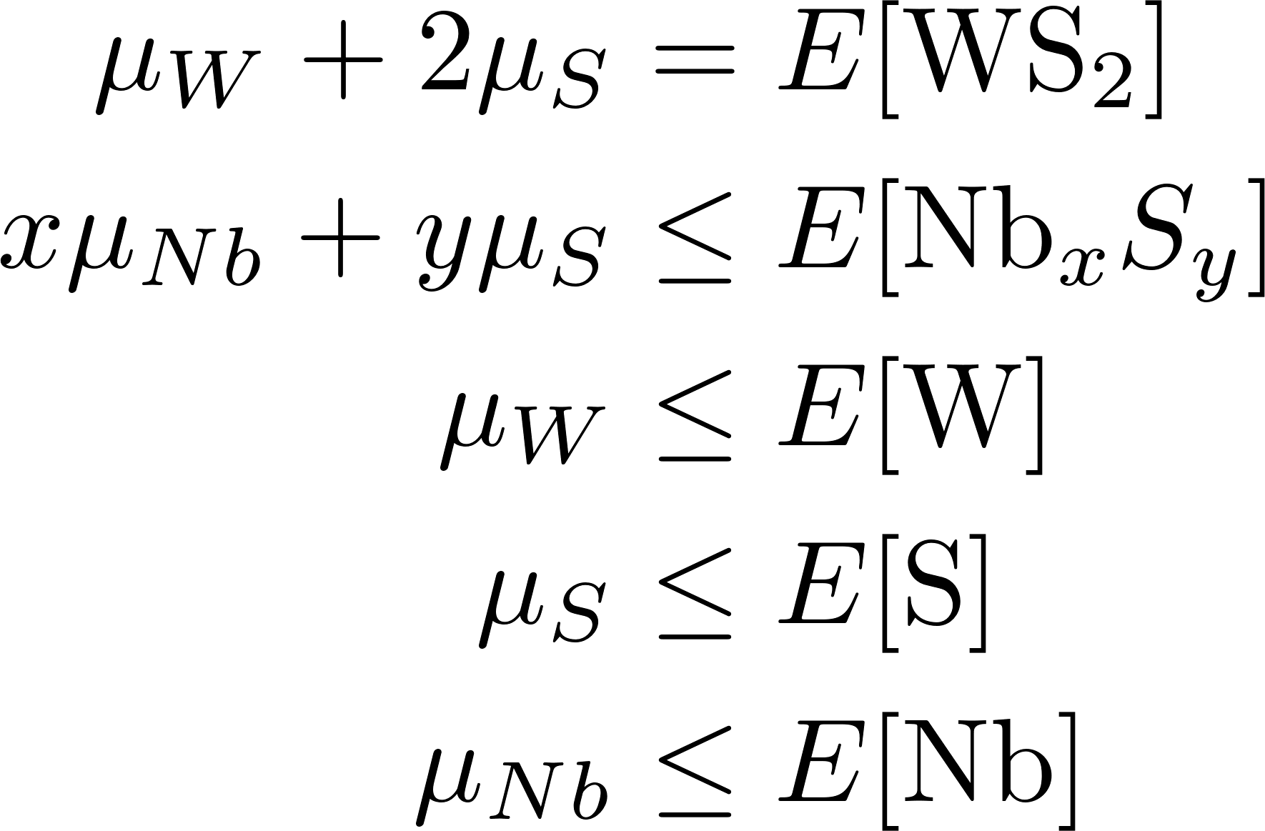
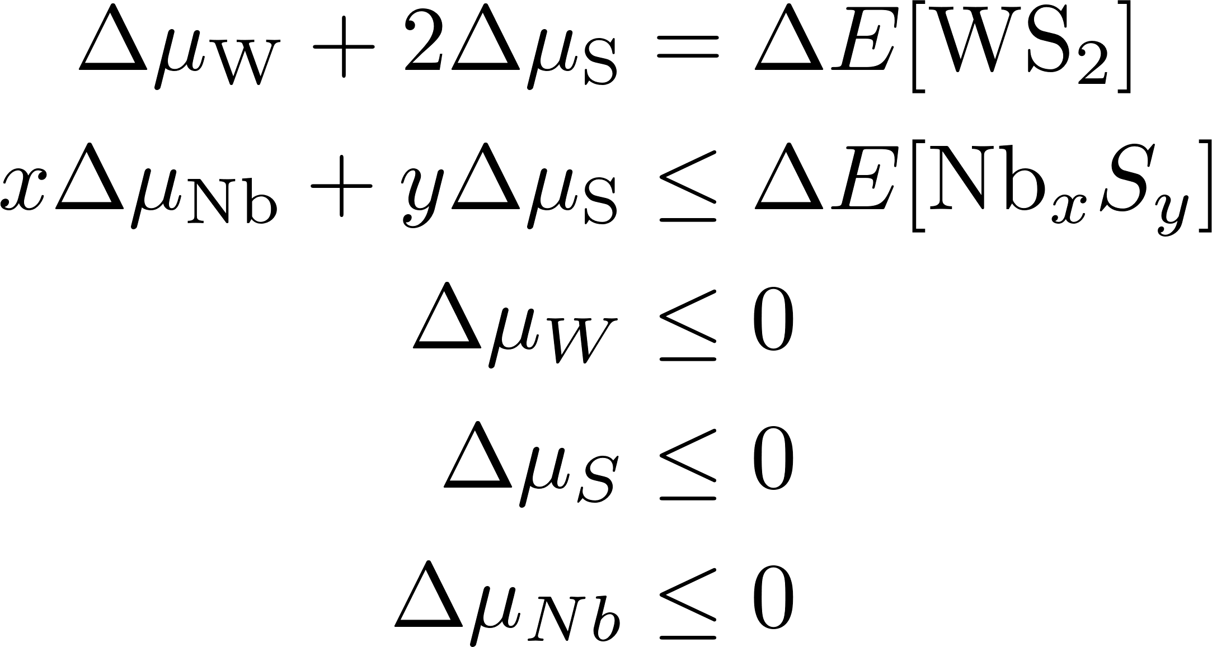





Atom Chemical Potential
Constraints by phase stability:
(1)
(7)
(2)
(8)
(3)
(6)
(9)
(4)
(10)
(5)
(11)
E[A]: energy per formula unit
(12)
In electronic-structure calculations, chemical potentials can be referenced to the total energy of the elemental phases at T = 0 K.
Energy enthalpy and formation energy are considered to have the same value since the pressure is small enough after relaxation.
Notes:
对于缺陷 没那么复杂 since there is an equation constraints by host compounds
In principle, all of the chemical potentials are, free variables that indicate the conditions of the surrounding environment while the defect is formed. However, they are subject to specific bounds. For atoms, the constraints come from phase stability.
under equilibrium growth conditions
Since the defect must form in WS2 the chemical potentials are bounded by equation 1. The limits are also set by the stability of the elemental phases and competing compounds of the constituent elements, described by inequalities 2-5. There are no other secondary phases for tungsten (W) and sulfur (S), we only need inequality 2 for niobium (Nb) and sulfur (S).
In electronic-structure calculations, chemical potentials are always referenced to the total energy of the elementary phases at 0 K, that is Δμ. Therefore, equivalent constraints are established with Δμ and ΔE. This set of constraints is employed here.
The inequalities and equality constraints

Slide 12
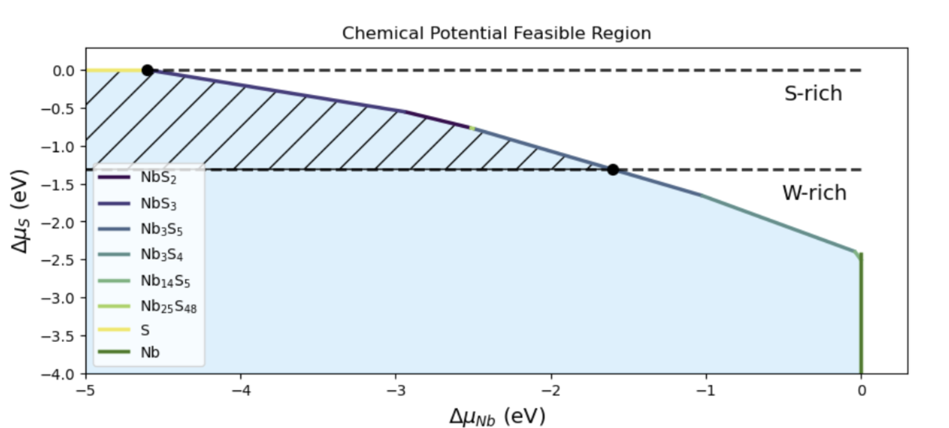
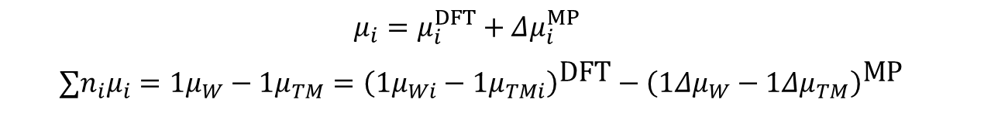
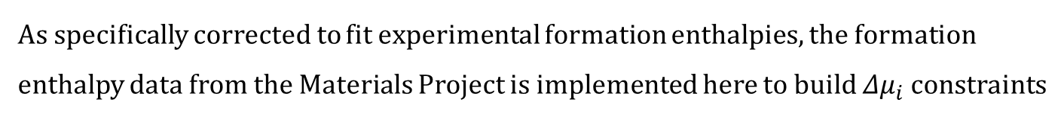
Atom Chemical Potential
As specifically corrected to fit experimental formation enthalpies, the formation enthalpy data from the Materials Project is implemented here to build $Δμ_{i}$constraints
$$μ_{i}=μ_{i}^{DFT}+Δμ_{i}^{MP}$$
$$∑n_{i}μ_{i}=1μ_{W}−1μ_{TM}={\left(1μ_{Wi}−1μ_{TMi}\right)}^{\text{DFT}}−{\left(1Δμ_{W}−1Δμ_{TM}\right)}^{\text{MP}}$$
Notes:
Take Nb as an illustrative example.

Slide 13
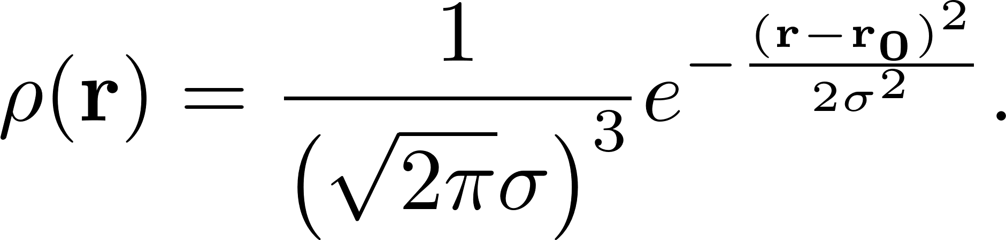
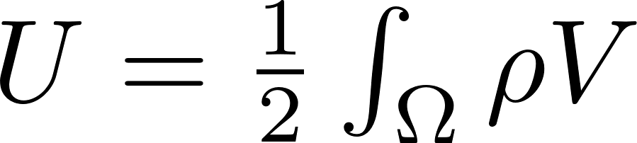
Charge Correction
The isolated charged defect → periodically repeated array of defects
artificial electrostatic interactions
Supercell approach:
The FNV scheme:
Image charge
Determine the z-dependent dielectric function
use a model charge distribution to emulate the behavior of the defect charge state, and find the model potential by solving the Poisson equation.
Do it twice with periodic boundary conditions and zero boundary conditions. The electrostatic energy is given by:
Notes:
In supercell approach (employ periodic boundary conditions), the isolated charged defect is replaced by periodically repeated array of defects. Such a periodic array contains unrealistically large defect concentrations, resulting in artificial interactions between the defects.
These interactions are long-ranged so the convergence with respect to supercell size is slow.
The correction consists in subtracting the spurious interactions between the periodic charge and adding in the energy of an isolated charge distribution. And there is an alignment term due to the different reference in DFT and in the model calculation.
The FNV scheme operates as follows:
The required VASP results are

Slide 14
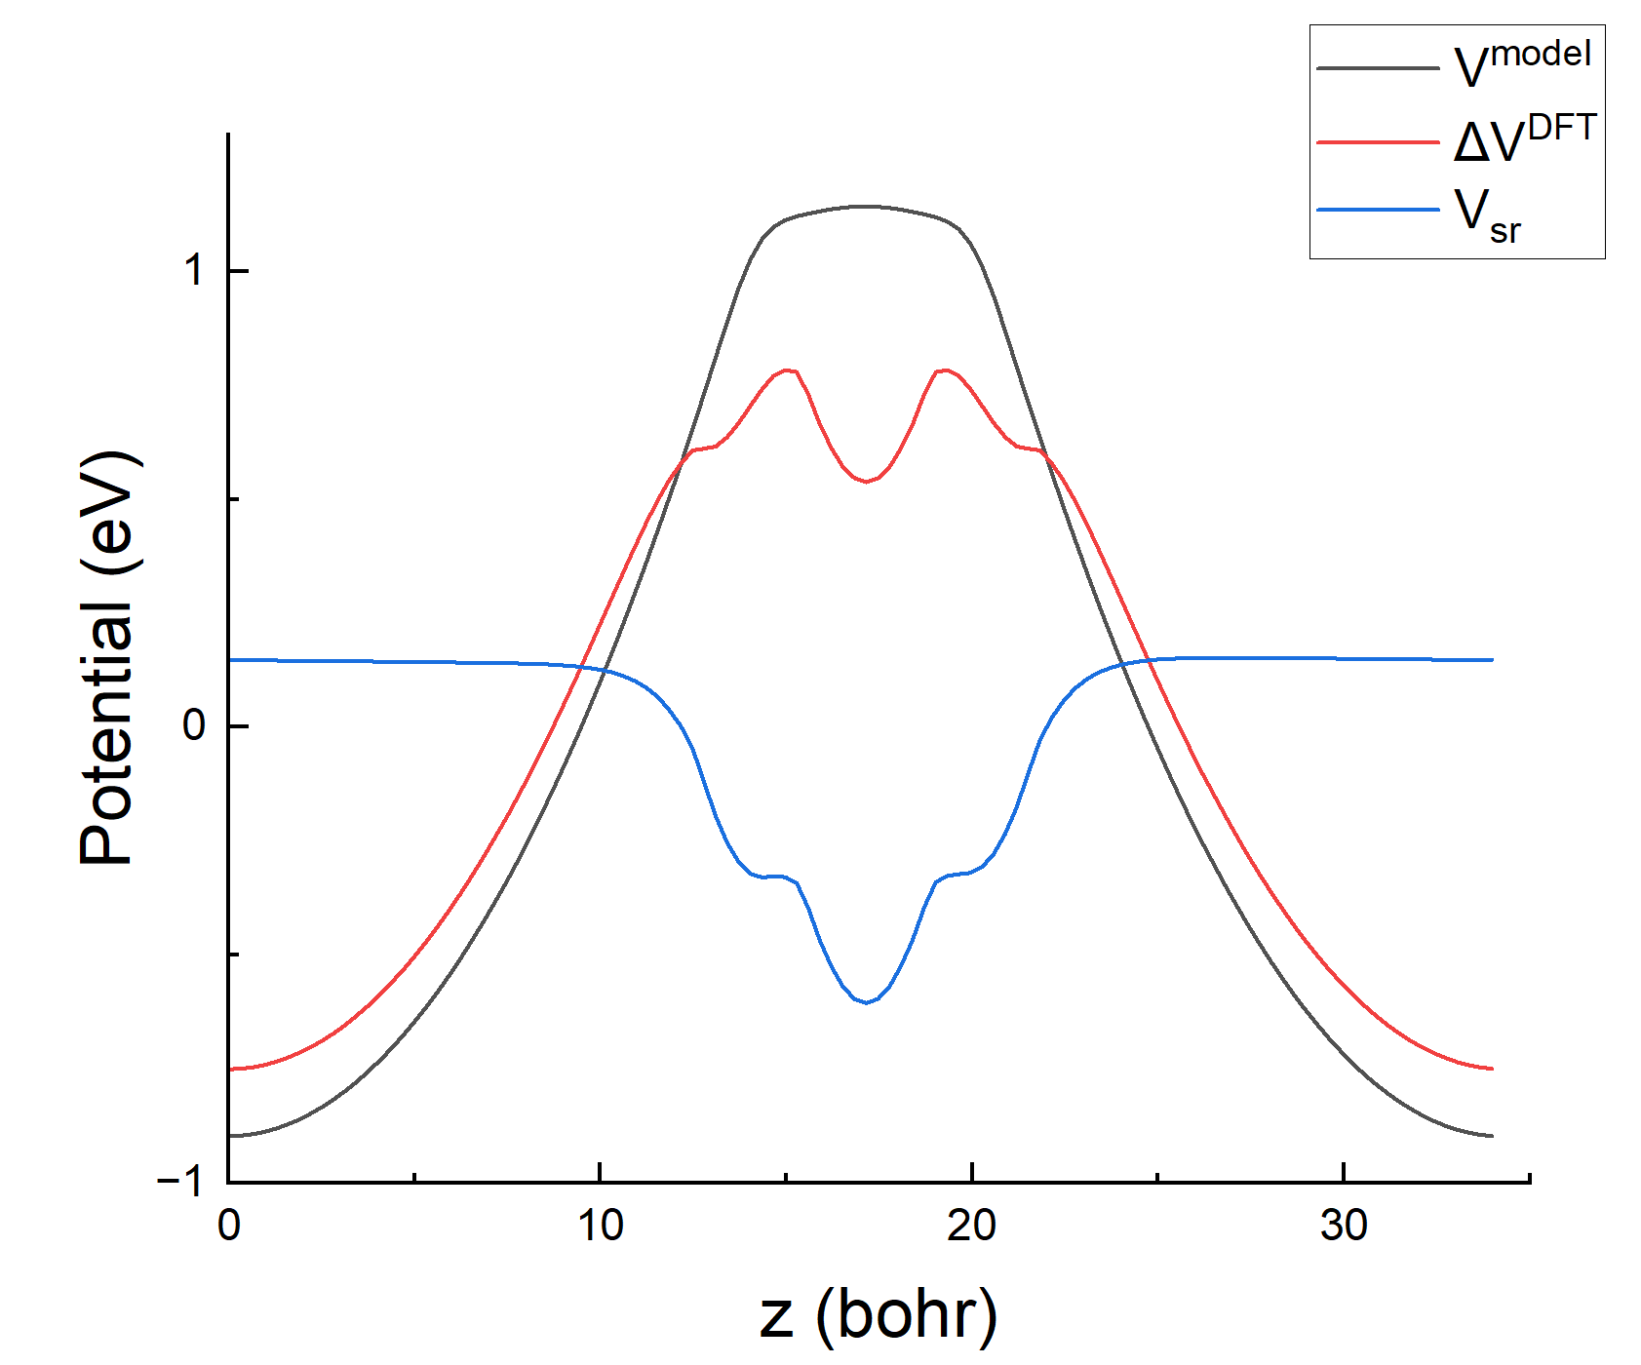
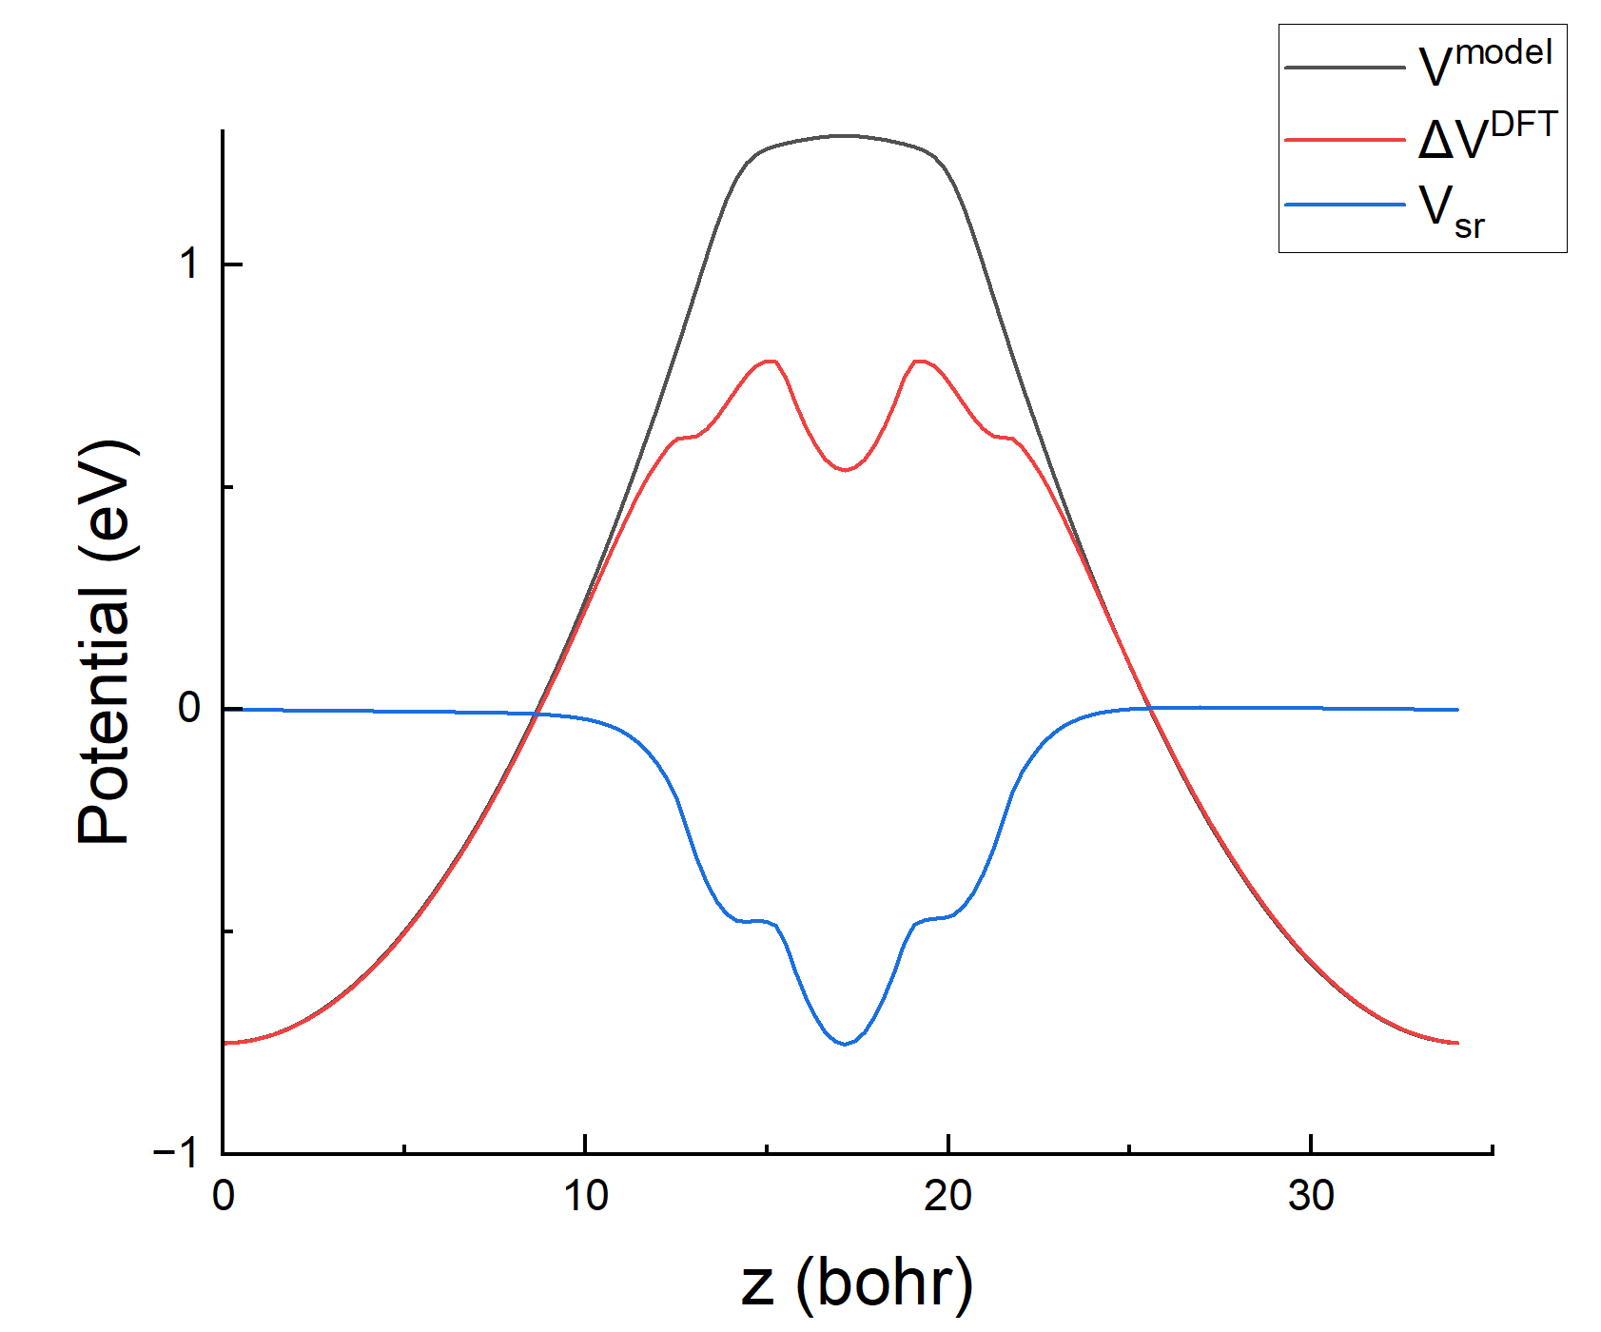
Charge Correction
Potential alignment:
Manually set C until potential alignment:
(away form defect)
Correction Energy: +1 : 0.094 eV -1 : 0.071 eV
Notes:
The FNV finite-size correction can work only with the DFT electrostatic and the dielectric constant of the material. 准确的缺陷位置·
The planar-averaged values of the different potentials involved in calculating the FNV charge-state correction. The long-range (black) term is computed from a Gaussian model, the potential difference (red) and short-range terms(blue). The difference in electrostatic potentials between the defect and pristine cells and the short-range potential are both directly computed from the files storing the electrostatic potential information file (e.g. LOCPOT files for VASP calculations)..

Slide 15
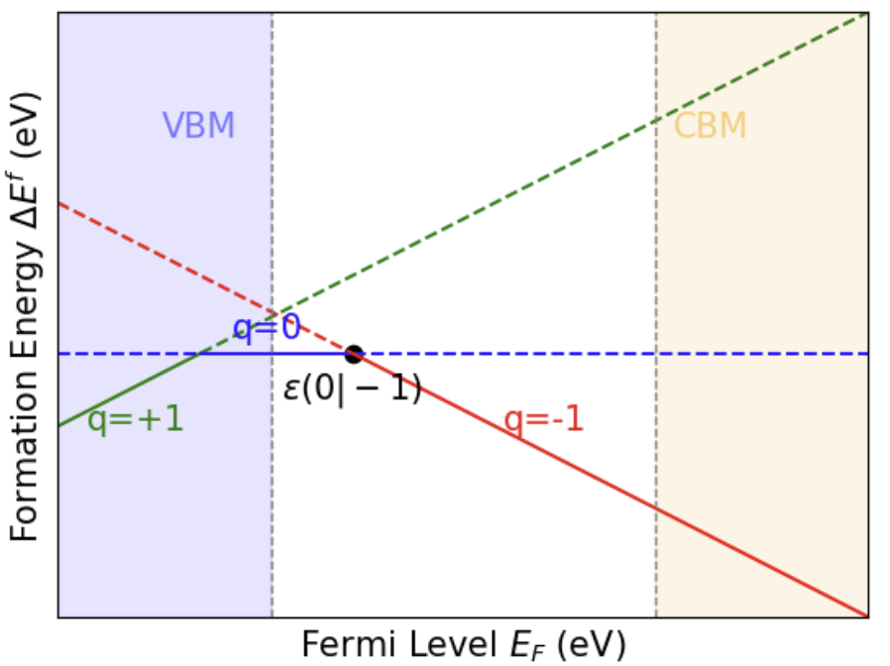
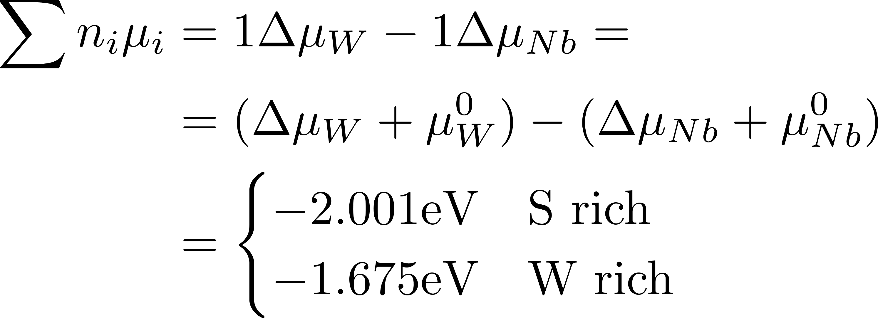
Formation Energy Diagram
Table 3 Formation energy values of charge states +1, 0, -1.
Defect | q | E_{D,q} - E_{Host} | qE_{VBM} | Σn_{i}μ_{i} (S-rch/Wrich) | E_{corr} | Ef(E_{F}=VBM) (S-rch/W-rich)
Nb_{W}⁺¹ | +1 | 4.076 | -1.518 | -2.001/-1.675 | 0.094 | 0.651/0,977
Nb_{W}⁰ | 0 | 2.232 | 0 | -2.001/-1.675 | 0 | 0.231/0.557
Nb_{W}⁻¹ | -1 | 1.098 | 1.518 | -2.001/-1.675 | 0.071 | 0.686/1.012
Notes:
All the 4 terms in formation energy equation have been determined
Regard the formation energy as function of fermi level → formation energy Diagram is plotted here
The charge state within bandgap is 0 and -1 with transition energy level equals to 0.386 eV
Additionally, spin states are evaluated for the -1 charge state → singlet ground state Favorable Nb formation energy not all TM defect一样 Nb最小

Slide 16
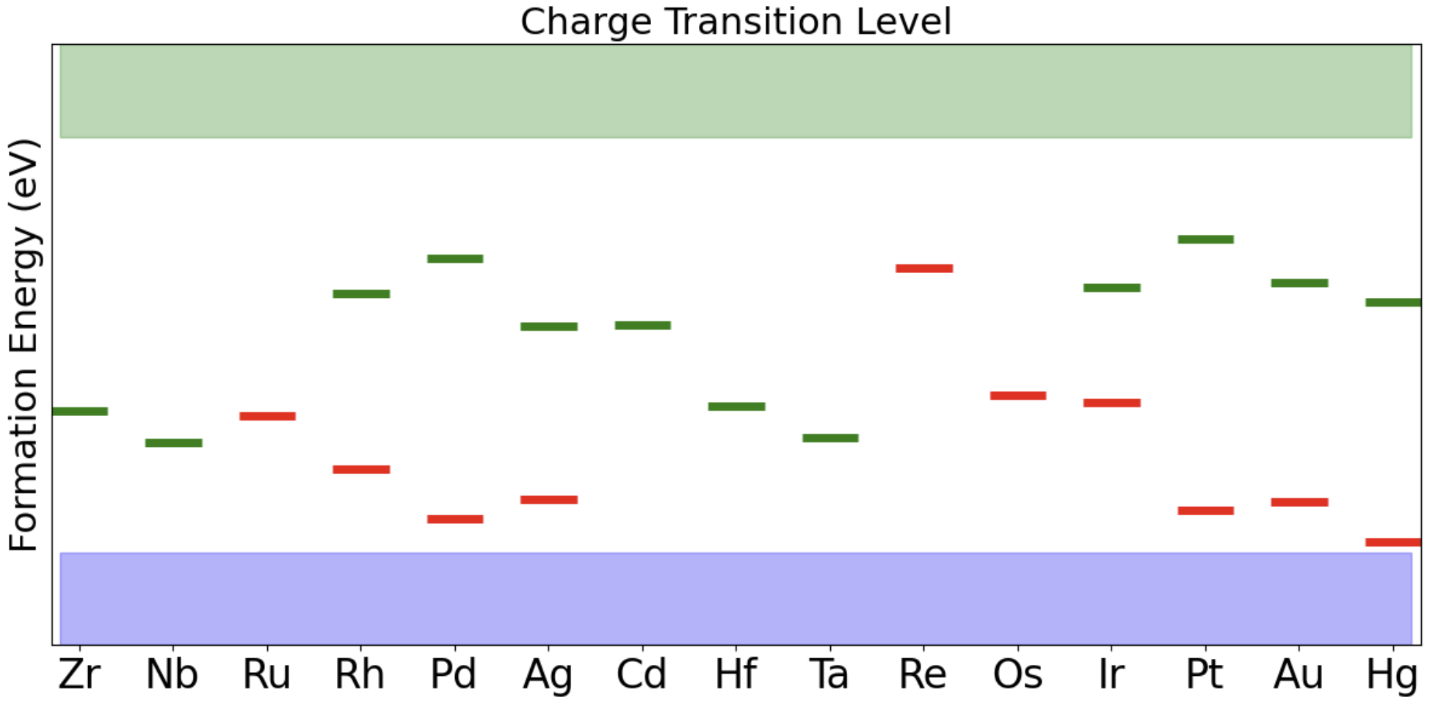
Charge Transition Level
4d
Mo
5d
W
Notes:
Molybdenum (Mo) and tungsten (W) Vertical dotted line
In 4d and 5d, region divided by Mo/W
starting from the first group to the right of Mo and W (vertical lines in Fig. 2), the (0/-1) and (+1/0) CTLs generally shift down as the group corresponding to the TM dopant shifts right across the periodic table to Group IIB, and this trend continues as we loop back to Group IVB, followed by Group VB (Fig. 2). These trends make sense because dopants with fewer valence electrons than elements in group VIB (Cr/Mo/W) have a tendency to accept electrons in MoS2 and WSe2, while those with more valence electrons tend to lose electrons. Nevertheless, it is evident that, for a considerable number of elements, the neutral, –1 and +1 charge states can all be stabilized with an appropriate Fermi level in the band gap.

Slide 17
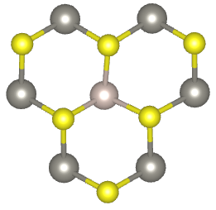
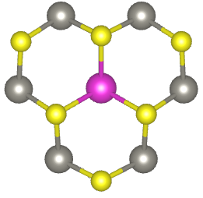
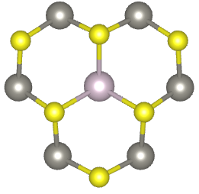
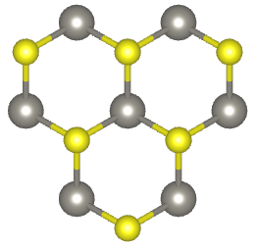

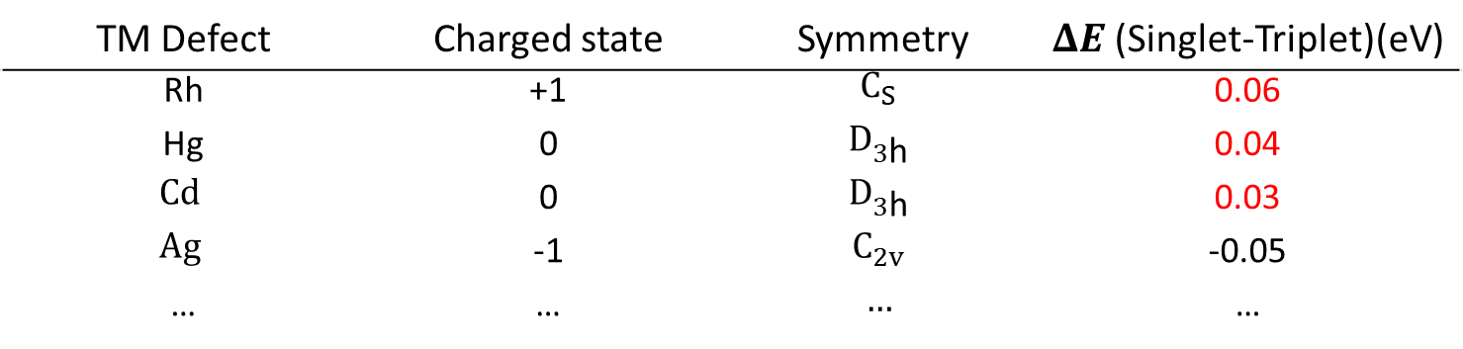



Spin Configuration
TM Defect | Charged state | Symmetry | $ΔE$ (Singlet-Triplet)(eV)
Rh | +1 | $$C_{S}$$ | 0.06
Hg | 0 | $$D_{3\text{h}}$$ | 0.04
$$Cd$$ | 0 | $$D_{3\text{h}}$$ | 0.03
$$Ag$$ | -1 | $$C_{2v}$$ | -0.05
… | … | $$…$$ | …
In-plane strain for triplet ground state structure:
Rh¹⁺
Hg⁰
Cd⁰
Pristine
3.28 Å
3.12 Å
3.28 Å
3.61 Å
3.56 Å
3.19 Å
$$C_{S}$$
$$D_{3\text{h}}$$
$$D_{3\text{h}}$$
$$D_{3\text{h}}$$
Notes:
As spin triplet system are necessary for potential spin qubits, the ground state spin multiplicity is examined for all possible charged defects
For these three triplet ground defect, their relaxed local configurations are checked here. Distance between sulfur atoms are measured to assess the in-plane strain. The S-S distance is 3.19 angstrom in pristine geometry. Although the neutral Hg and Cd defect maintain the D3h point group symmetry, they exhibit a relatively large tensile strain. The Rh defect in charge state +1 have a reduced symmetry Cs, but it present a much weaker tensile strain. This observation may indicate that distortion cannot be characterized only by point group symmetry.

Slide 18
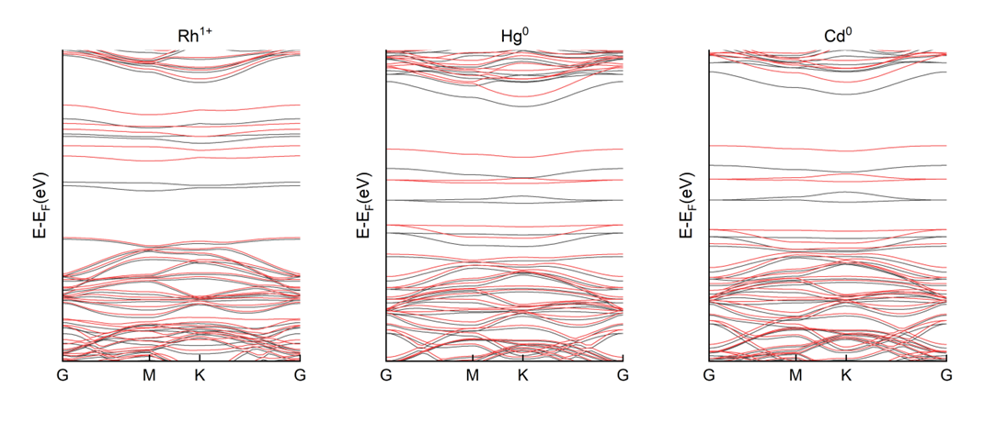
Bandstructure
a₁’
a₁’
e’x ,e’y
e’x ,e’y
Calculated band structure of triplet ground state defects
Notes:
No deep level can be observed

Slide 19
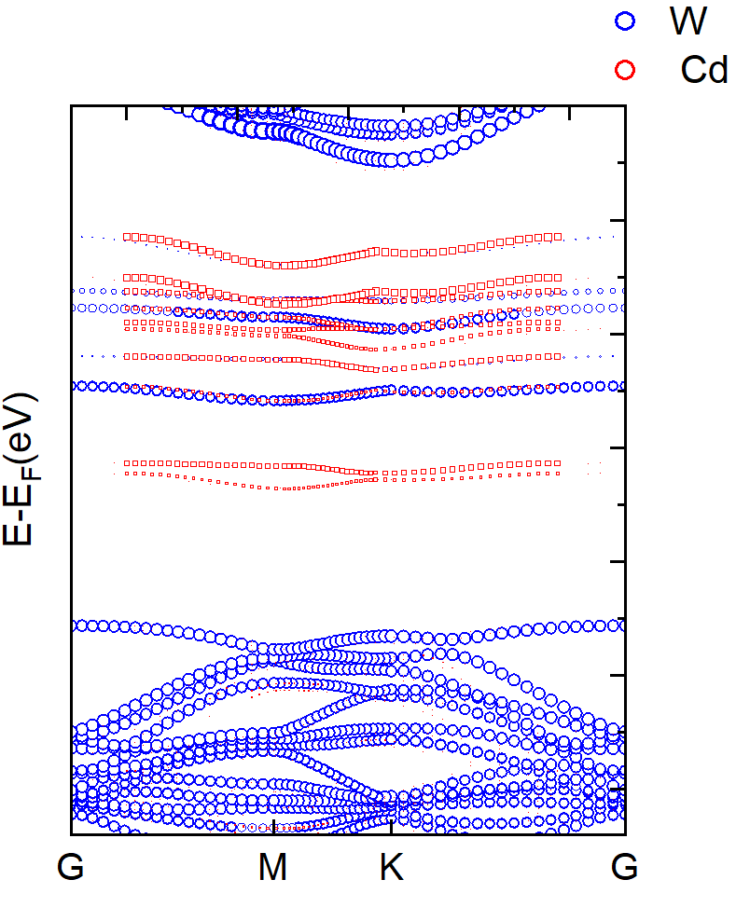

Slide 20
THANK YOU

Slide 21
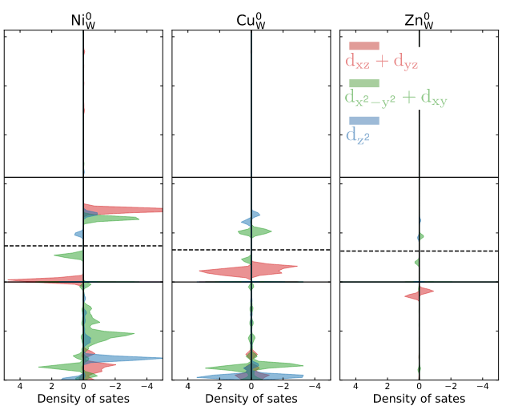
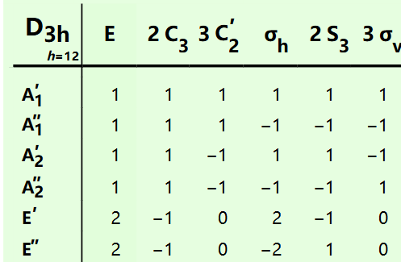
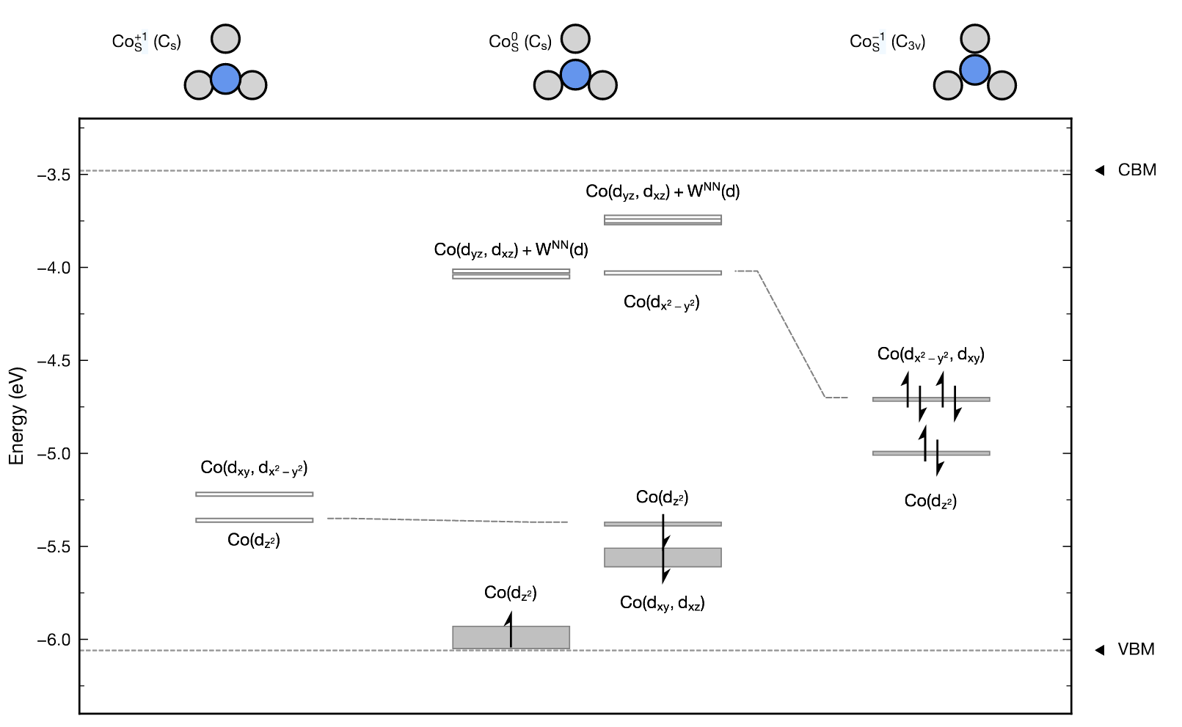
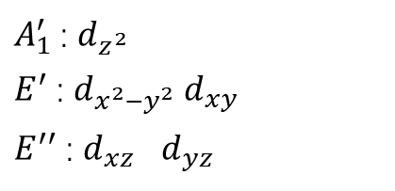

$$d= A_{1}⊕E^{′}⊕E^{′′}$$
$A_{1}^{′}$ : $d_{z^{2}}$
$E^{′}$ : $d_{x^{2}−y^{2}}$ $d_{xy}$
$E^{′′}$ : $d_{xz}$ $d_{yz}$

Slide 22
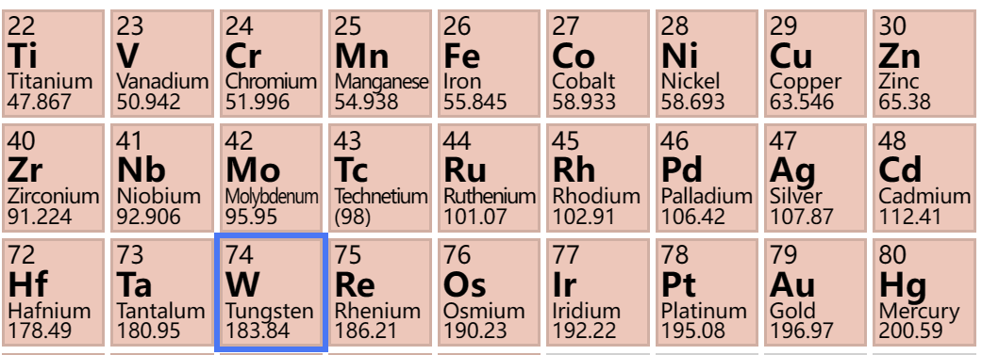
Future Plan
Determine defect supercell
manually set different initial dopant positions
Apply the above analysis for TM substitutional defects in 2D WS₂ and make it a screening workflow
Explore the automation of the computational process
More preoerties about selected candidates
ground state structure
with possible symmetry distortion
Calculate formation energy
defect charge states within pristine bandgap?
Y
Bandstructure analysis
deep level?
Y
Evaluate spin multiplet
triplet ground state?
Y
Fig. 9 3d, 4d and 5d TM element
candidates
Notes:
My current work is about …
DFT detail k-point
3d, 4d and 5d TM element from group IVB to IIB

